Slide 1
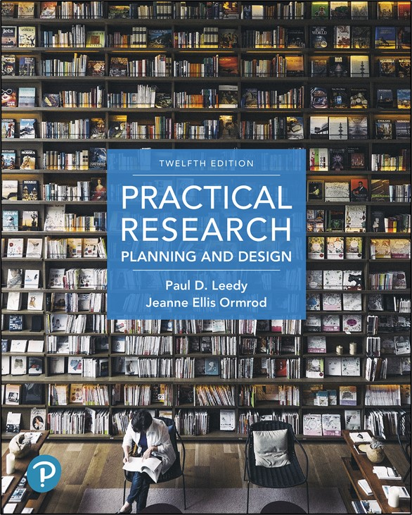
Practical Research: Planning and Design
Twelfth Edition
Chapter 6
Descriptive Research
Copyright © 2019, 2016, 2013 Pearson Education, Inc. All Rights Reserved
Notes:
If this PowerPoint presentation contains mathematical equations, you may need to check that your computer has the following installed:
1) Math Type Plugin
2) Math Player (free versions available)
3) NVDA Reader (free versions available)

Slide 2
Descriptive Research Designs
Observation studies
Correlational research
Developmental design
Survey research

Slide 3
Quantitative Observation Studies
Involve humans, other animals, plants, nonliving objects
Focus is limited, pre-specified
Quantify behavior
Require planning, attention to detail, and time
Provide a quantitative alternative to qualitative approaches

Slide 4
Maintaining Objectivity in Observation Studies (1 of 2)
Define the behavior precisely and concretely
Should be easily recognized
Divide the observation period into small segments
Record whether the behavior does or does not occur

Slide 5
Maintaining Objectivity in Observation Studies (2 of 2)
Use a rating scale to evaluate the behavior in terms of specific dimensions
Have people rate the same behavior independently
Train the raters to use specific criteria until consistent ratings are obtained

Slide 6
Correlational Research (1 of 2)
Examines the extent to which differences in one variable are related to differences in other variables
Researchers gather data about two or more characteristics for a particular group to see if these characteristics are interrelated

Slide 7
Correlational Research (2 of 2)
Scatter plots show the overall pattern and describe the interrelationship
Correlation does not, in and of itself, indicate causation

Slide 8
Developmental Designs
Cross-sectional study
people from several different groups are sampled and compared
Longitudinal study
a single group of people is followed over time, and data are collected at various times

Slide 9
Pros and Cons: Cross-Sectional Versus. Longitudinal Study (1 of 2)
Cross-sectional studies:
Pro
All the data can be collected at one time
Con
Different populations may represent different life experiences (threat to internal validity)

Slide 10
Pros and Cons: Cross-Sectional Versus. Longitudinal Study (2 of 2)
Longitudinal studies:
Pro
Correlations between characteristics at different times can be computed
Con
Participants may be lost to follow-up
Characteristic being measured may change because participants have experience with the instrument

Slide 11
Compromise: Cohort-Sequential Design
Addresses weaknesses of longitudinal and cross-sectional designs
Includes two or more age groups (the cross-sectional piece), followed over a period of time (the longitudinal piece)
Allows calculation of correlations between measures taken at two different time periods
Predictions can be made across time

Slide 12
Experience-Sampling Methods (E S M)
An experience-sampling method (E S M) is an approach in which a researcher collects frequent and ongoing data about people as they live their normal, everyday lives
Successfully used in both quantitative and qualitative projects
Advantages of E S M methods:
Potential for increased accuracy and validity of assessments
Researcher gains data that might be useful in determining test-retest reliability.
Useful if the researcher wants to collect longitudinal data as a means of investigating any short-term changes in characteristic as environmental or behavioral variables change

Slide 13
Survey Research
Goal is to learn about a large population by surveying a sample of that population
Also called a descriptive survey or normative survey
Simple design – researcher poses a series of questions, quantifies responses, and draws inferences about a population
Captures a fleeting moment of time — extrapolation can be made about a longer period of time

Slide 14
Types of Survey Research
Interview
Structured or semi-structured
Face-to-face, telephone, video conference
High response rate
Questionnaire
Paper-and-pencil or computerized
Low return rate
Assurance of remaining anonymous

Slide 15
Data Collection (1 of 2)
Checklist: a list of behaviors, characteristics, or other entities under investigation
Limited information: observed or not observed
Rating scale: used to evaluate a behavior, attitude etc. on a continuum (“never” to “always”)

Slide 16
Data Collection (2 of 2)
May be ordinal or interval scale
People may not interpret scale the same way
Rubric: two or more rating scales, with concrete descriptions of behavior for each scale point
Scales may not address the same things

Slide 17
Computerizing Observations
Use a computer to record what you see
Use a spreadsheet to organize the data
Consider software specific to your purpose

Slide 18
Conducting Interviews in a Quantitative Study (1 of 2)
Ask questions that help answer the research question
Write questions with quantifiable answers (numerical codes)
Restrict questions to a single idea
Consider asking a few questions to elicit qualitative data
Use a computer to streamline the process

Slide 19
Conducting Interviews in a Quantitative Study (2 of 2)
Conduct pilot test(s)
Introduce yourself and explain the purpose of the study
Be sure participants offer informed consent in writing
Ask controversial questions in the latter part of the interview
Seek clarifying information as needed

Slide 20
Constructing a Questionnaire (1 of 3)
Keep it short
Keep the respondent’s task simple
Provide specific instructions
Use simple, clear, unambiguous language

Slide 21
Constructing a Questionnaire (2 of 3)
Give a rationale for any item for which the purpose is unclear
Check for unwarranted assumptions implicit in the question
Word your questions in ways that don’t give clues about preferred or more desirable responses
Determine in advance how you will code the responses

Slide 22
Constructing a Questionnaire (3 of 3)
Check for consistency
Conduct one or more pilot tests to determine the validity of your questionnaire
Scrutinize the almost-final product to make sure it addresses your needs
Make the questionnaire attractive and professional looking

Slide 23
Using Technology When Administering Questionnaires
Ask participants in the same location to answer directly on a laptop or tablet
When participants are at diverse locations, use email to request participation and obtain responses
If you use paper mail delivery, us a word-processing program to personalize your correspondence
Use a scanner to facilitate data tabulation
Use a computer database to keep track of who has responded and who has not

Slide 24
Maximizing the Return Rate (1 of 2)
Consider the timing
Avoid holidays and vacation times
Make a good first impression
Motivate potential respondents
Write a great cover letter
Include a self-addressed envelope with prepaid postage
Offer to send the results of your study
If mailing your questionnaire, include a self-addressed envelope with return package.

Slide 25
Maximizing the Return Rate (2 of 2)
Offer the results of your study
Be gently persistent
Consider sending two follow-up reminders
Send reminders a week or two after the previous mailing

Slide 26
Choosing a Sample in a Descriptive Study
Any researcher who conducts a descriptive study wants to determine the nature of how things are…
It isn’t possible to survey an entire population of interest, so researchers select a subset, or sample, of the population.
A good sample is representative of the population.
This is what quantitative researchers refer to as external validity, of the extent to which the study’s findings can be reasonably generalized beyond the partcipants in the study.

Slide 27
Probability Sampling
Probability sampling: researcher specifies in advance that each segment of the population is represented in the sample
Requires random selection

Slide 28
Random Selection
Each member of the population has an equal chance of being selected
Characteristics of the sample are assumed to approximate the characteristics of the total population
Tables of random numbers or computer programs are used to select from a list of the population

Slide 29
Probability Sampling Techniques (1 of 4)
Simple random sampling: Researcher numbers everyone in the population and then uses random number generator to select participants
Stratified random sampling: Researcher identifies strata — different groups in population — and samples equally from each one
Example: 10 students in each grade

Slide 30
Probability Sampling Techniques (2 of 4)
Proportional stratified sampling: Researcher identifies strata and samples from each one based on its proportion in the population
Example:
population: 100 first graders, 200 second graders
sample: 10 first graders, 20 second graders

Slide 31
Probability Sampling Techniques (3 of 4)
Cluster sampling: Researcher subdivides a large area into smaller units (clusters), selects a subset of clusters, and then selects individuals randomly from each identified cluster
Example:
Population = all students in a district with 1200 schools
Clusters = townships within the district

Slide 32
Probability Sampling Techniques (4 of 4)
Systematic sampling: researcher selects individuals/clusters according to predetermined sequence, which must originate by chance
Example:
Scramble the list of people randomly
Then pick every nth person

Slide 33
Nonprobability Sampling
Nonprobability sampling: researcher cannot guarantee that each element of the population will be represented in the sample
Some members of the population have little or no chance of being sampled

Slide 34
Nonprobability Sampling Techniques (1 of 3)
Convenience sampling (accidental sampling)
Researcher takes samples that are readily available.
Example: People who arrive at the store for breakfast

Slide 35
Nonprobability Sampling Techniques (2 of 3)
Quota sampling:
Researcher conveniently selects participants in the same proportion that they are found in the general population, but not in a random fashion
Example population: 100 first graders, 200 second graders
Example sample: the first 10 first graders and the first 20 second graders who arrive at school that day

Slide 36
Nonprobability Sampling Techniques (3 of 3)
Purposive sampling: Researcher choose participants for a particular purpose
People from voting districts that, in the past, have been helpful in predicting the election outcome
The researcher must always provide a rationale explaining the selection of a particular sample

Slide 37
Surveys of Very Large Populations (1 of 2)
Multistage sampling:
Divide country into primary areas, randomly select areas to sample
Divide the primary areas into sample locations, randomly select locations to sample
Divide sample locations into chunks, randomly select chunks to sample

Slide 38
Surveys of Very Large Populations (2 of 2)
Multistage sampling:
Divide chunks into segments, randomly select segments to sample
Divide segments into units, randomly select units to sample

Slide 39
Identifying a Sufficient Sample Size (1 of 2)
Basic rule: The larger the sample, the better
For smaller populations (N =100 or fewer), survey the entire population
If population is around 500, sample 50%
If population is around 1,500, sample 20%

Slide 40
Identifying a Sufficient Sample Size (2 of 2)
If population is over 5,000, a sample size of 400 is fine
The larger the population, the smaller the percentage
Need a representative sample

Slide 41
Sources of Bias (1 of 4)
Bias
any influence, condition, or set of conditions that distort the data
Researchers should try to avoid bias, but acknowledge that it occurs

Slide 42
Sources of Bias (2 of 4)
Sampling Bias
occurs when any factor(s) leads to a non-representative sample of the population
Examples:
Selecting from phone book (no land line?)
Using an online survey (no Internet?)
Mailing questionnaires (low or selective response rate?)

Slide 43
Strategies for Identifying Sampling Bias
Look for items that may be influenced by factors that distinguish respondents from nonrespondents.
interests, education level, age, etc.
Compare responses that were returned quickly with those that were returned later.
late responses often look like what you’d expect from nonrespondents
Randomly select a small number of nonrespondents and try to contact them.

Slide 44
Sources of Bias (3 of 4)
Instrumentation bias
measurement instruments slant the results
questions lead to particular answers
Response bias
participants say what they think researcher wants to hear
participants want to create favorable impression (social desirability effect)

Slide 45
Sources of Bias (4 of 4)
Researcher bias
researchers have a point of view
researchers choose what they want to study
researchers make subjective interpretations

Slide 46
Interpreting the Data
Don’t forget — it’s “descriptive” research, but you still have to interpret the data
Two basic principles of research:
The purpose of research is to seek the answer to a problem or question in light of data that relate to the problem or question.
Although collecting data for study and organizing it for inspection require care and precision, extracting meaning from the data is paramount and should never be neglected.

Slide 47
Questions to Ask Yourself (1 of 2)
Why is a description of this population and/or phenomenon valuable?
What specific data will you need to address your research problem and its subproblems?
What procedures should you use to obtain the needed information? How can you best implement those procedures?
How can you get a sample that will reasonably represent the overall population about which you are concerned?

Slide 48
Questions to Ask Yourself (2 of 2)
How can you control for possible bias in your collection of data?
What will you do with the data once you have collected them? How might you best organize and prepare them for analysis?
Above all, in what ways might you reasonably interpret your data? What conclusions might you reach from your investigation?

Slide 49

Copyright
This work is protected by United States copyright laws and is provided solely for the use of instructors in teaching their courses and assessing student learning. Dissemination or sale of any part of this work (including on the World Wide Web) will destroy the integrity of the work and is not permitted. The work and materials from it should never be made available to students except by instructors using the accompanying text in their classes. All recipients of this work are expected to abide by these restrictions and to honor the intended pedagogical purposes and the needs of other instructors who rely on these materials.

